Slide 1
CSCA08 AMACSS Review Seminar
Tabeeb Yeamin and Mohammad Moustafa

Slide 2
Dictionaries
{key: value}
Keys must be an immutable type, like string, int, tuple etc.
{[1,2,3]: ‘a’} will fail.
Value can be any type, can also be lists, sets, dicts etc.
{‘a’: [1,2,3], ‘b’: {1:(2,2,2)}}

Slide 3
Dictionaries
Initialization:
d = {}
d = dict() initializing set => set()
Dictionaries are NOT ordered! (Just like sets)
cannot do d[1]

Slide 4
Dictionaries
name_to_age = {‘Alice’: 30, ‘Bob’: 15, ‘Carol’: 45, ‘David’: 25, ‘Ed’: 35}
Access the values by using [key] or .get(key) method:
name_to_age[‘Alice’] => 30 invalid key gives error
name_to_age.get(‘Alice’) => 30 invalid key returns None
name_to_age.get(‘Alice’, -1) => 30 invalid key returns -1

Slide 5
Dictionaries
name_to_age = {‘Alice’: 30, ‘Bob’: 15, ‘Carol’: 45, ‘David’: 25, ‘Ed’: 35}
You can use elemental for loops to loop through the keys
for name in name_to_age:
print(name_to_age[name]) <= prints the ages
You can also get list of the keys by doing:
name_to_age.keys()
Returns dict keys object, a “list-like” object, but it does not support indexing.

Slide 6
Files
open(filename, mode) : a function that returns a filehandle object
(str, str) -> (io.TextIOWrapper)
mode:
‘r’: reading
‘w’: writing (erases previous data)
‘a’: appending
Close the filehandle object by doing:
filehandle.close()

Slide 7
Files (Reading)
filehandle.readline() : 1 line from the file
filehandle.read(): reads whole file into a single string
filehandle.readlines(): reads whole file into a list (each element is one line of text)

Slide 8

Files Example
HBD.txt has: filehandle.readline()
filehandle.read()
filehandle.readlines()

Slide 9
Files Example
HBD.txt has: filehandle.readline()
=> “HAPPY\n” (the \n will create a new line)
filehandle.read()
filehandle.readlines()

Slide 10
Files Example
HBD.txt has: filehandle.readline()
=> “HAPPY\n” (the \n will create a new line)
filehandle.read()
=> “HAPPY\n BIRTHDAY\nTO\nYOU”
filehandle.readlines()

Slide 11
Files Example
HBD.txt has: filehandle.readline()
=> “HAPPY\n” (the \n will create a new line)
filehandle.read()
=> “HAPPY\n BIRTHDAY\nTO\nYOU”
filehandle.readlines()
=> [“HAPPY\n”, “BIRTHDAY\n”, “TO\n”, “YOU”]

Slide 12
Files (Writing)
filehandle.write(text):
Only takes in strings
To create new lines you must include “\n”
You can also use “\t” to tab
Make sure to close your file afterwards, or it may not write

Slide 13
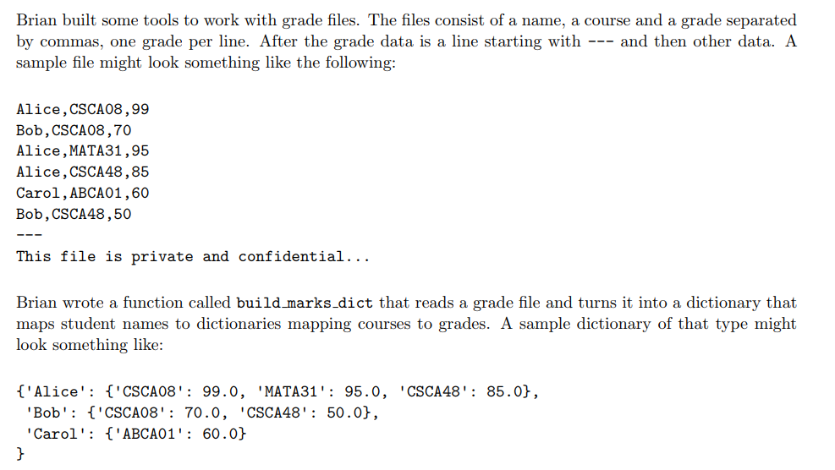
File + Dictionaries Example (2017 A08 TT2)

Slide 14
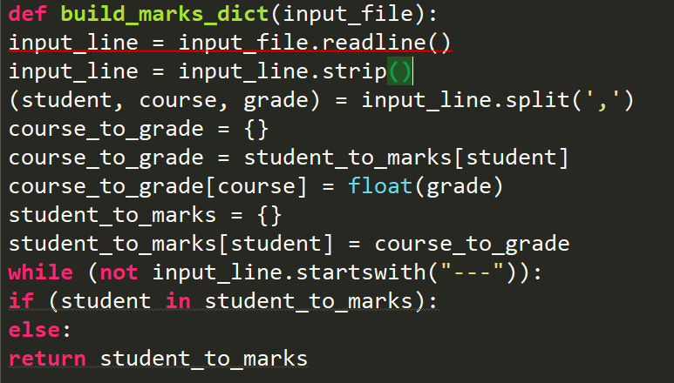
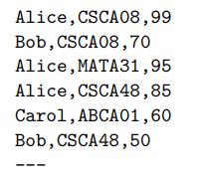
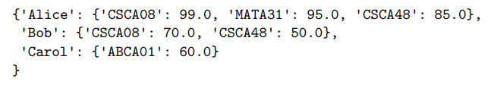
=>

Slide 15
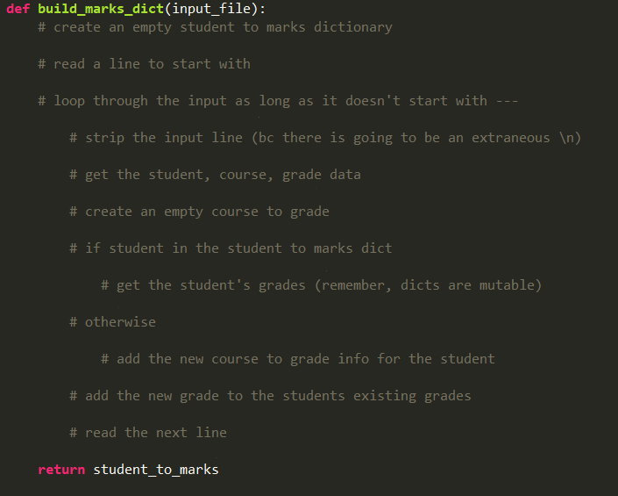
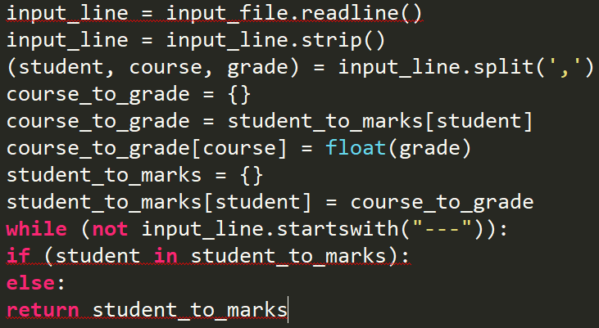

Slide 16
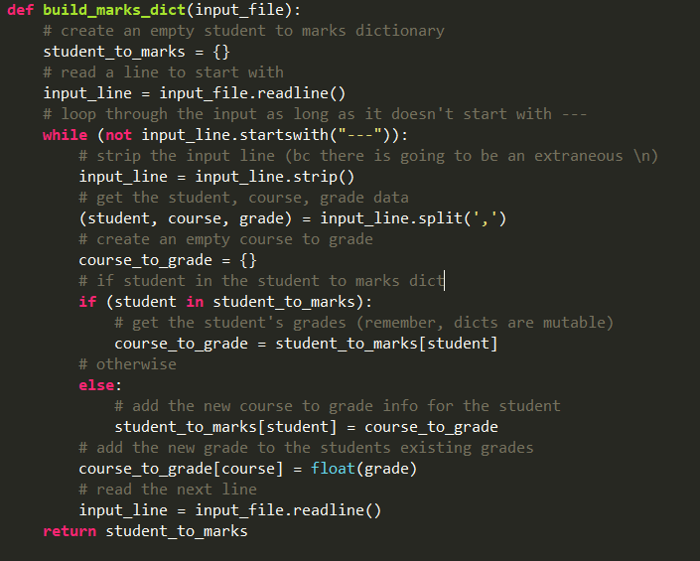

Slide 17
UnitTesting (Number Ranges)
Ex: 0 <= n <= 13
Test the edge cases, a number in between, and then above and below the range
n = 0
n = 13
0 < n < 13
n > 13
n < 0 (If valid input)
You don’t need to test invalid cases. I.e. if n refers to age, n >= 0 should be a REQ.

Slide 18
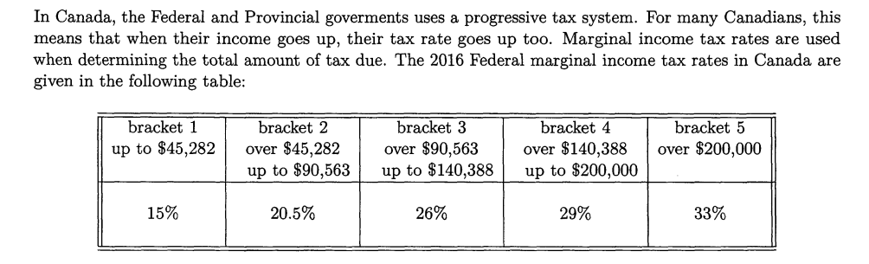
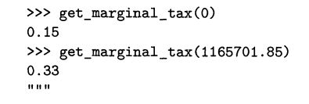
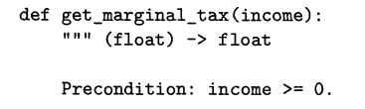
UnitTesting Ex 1 (April 2017 Final)

Slide 19
UnitTesting Ex 1 (April 2017 Final)
Test Case Description | Income ($) | Return value
0 | 0 | 0.15
In bracket 1 | 20, 000 | 0.15
Bracket 1 upper edge case | 45, 282 | 0.15
In bracket 2 | 60, 000 | 0.205
Bracket 2 upper edge case | 90, 563 | 0.205
In bracket 3 | 110, 000 | 0.26
Bracket 3 upper edge case | 140, 388 | 0.26
In bracket 4 | 160, 000 | 0.29
Bracket 4 upper edge case | 200, 000 | 0.29
Bracket 5 | 201, 000 | 0.33

Slide 20
UnitTesting Strings/Lists/Dicts etc.
Empty
One character/element
More than one character/element (May have to divide further depending on the question)

Slide 21
UnitTesting Strings Example
def is_palindrome(string: str) -> bool:
‘’’ Returns True iff string is a palindrome
Precondition: 0 <= len(string) <= 3
‘’’

Slide 22
UnitTesting Strings Example
len(string) | strings
0 | “”
1 | “a”
2 | “aa”, “ab”
3 | “aaa”, “aba”, “abb”, “aab”, “abc”

